Slide 1

GROUP MemberS:
Anusha Saad
Hermain qadir
Mohammad haroon
Jari sajjad

Slide 2

Indesign

Slide 3
What is InDesign?
InDesign is a desktop publishing software application for creating flyers, brochures, magazines, newspapers, and books. It is professional design and layout tool for producing high quality for both print and onscreen delivery.
InDesign is used by graphic designers, artists, publishers, and marketing professionals. It is developed and produced by Adobe Systems.

Slide 4
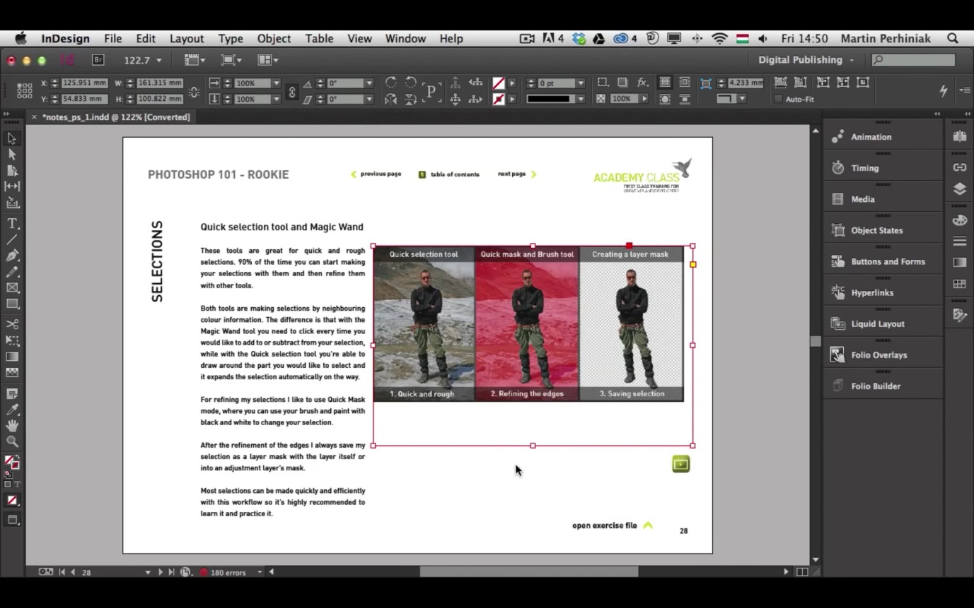
What does an Adobe InDesign do?
InDesign provides the tools necessary to design pages and create visual layouts. InDesign provides users a simplified way to create professional pages which can be published and distributed in print or online.
InDesign is especially useful for documents containing multiple pages, layouts that combine text and images, and those containing significant amounts of text.

Slide 5
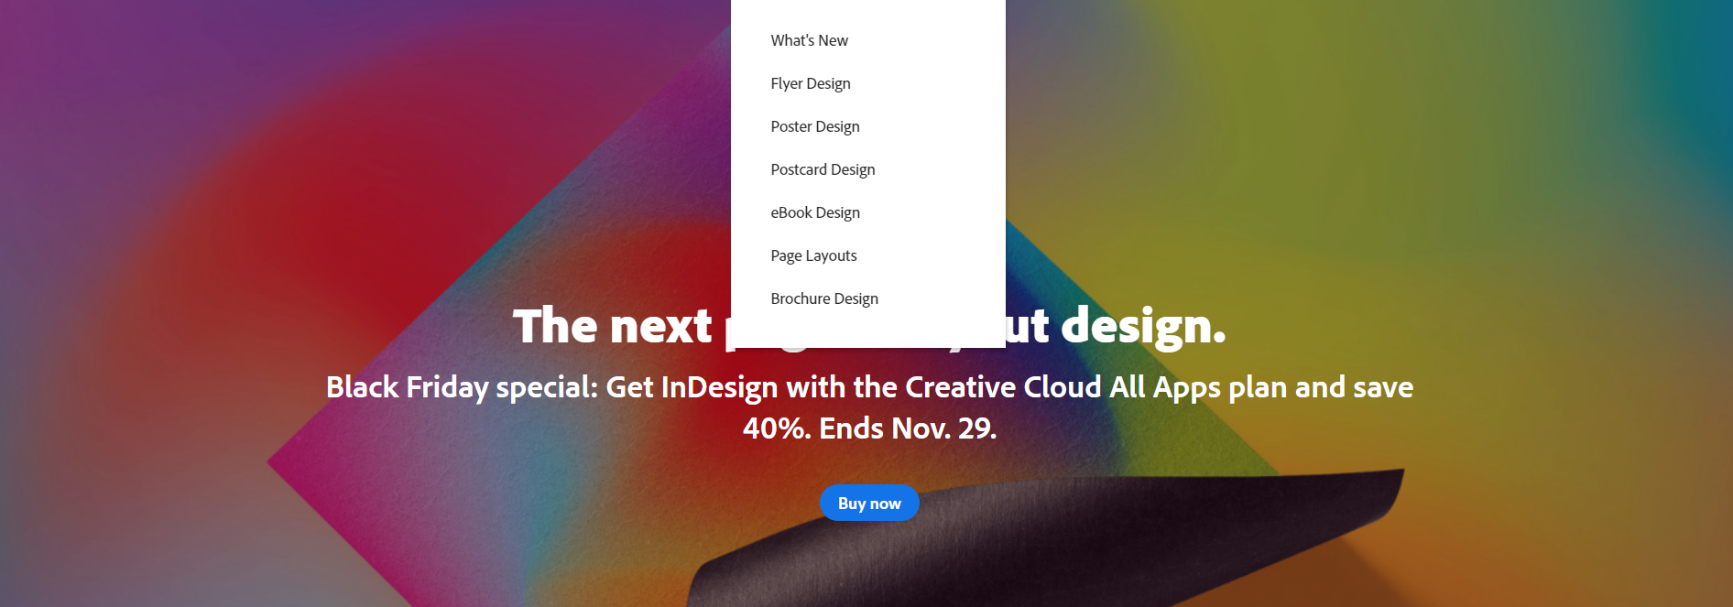
Features

Slide 6

TOOLBAR GLOSSARY

Slide 7






Direct Selection Tool
Page Tool
Content Collector Tool
Type Tool
Type on a Path Tool
Pen Tool
Pencil Tool
Smooth Tool

Slide 8

Rectangle Frame Tool
Ellipse Frame Tool
Free Transform Tool
Scale Tool
Shear Tool
Gradient Tool
Note Tool
Polygon Frame Tool

Slide 9



Hand Tool
Colour Palette
Selection tool
Scissor Tool
Rotate Tool
Colour Theme Tool
Convert Direction Point Tool

Slide 10
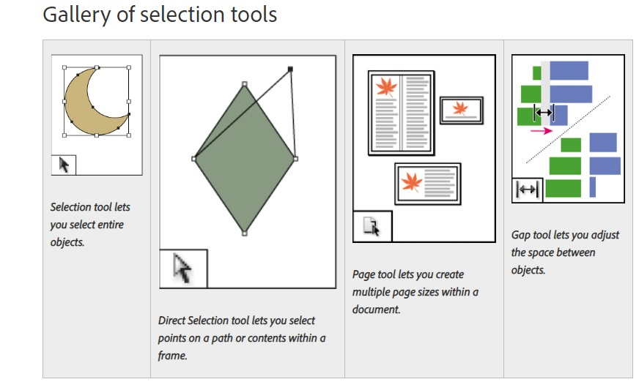

Slide 11
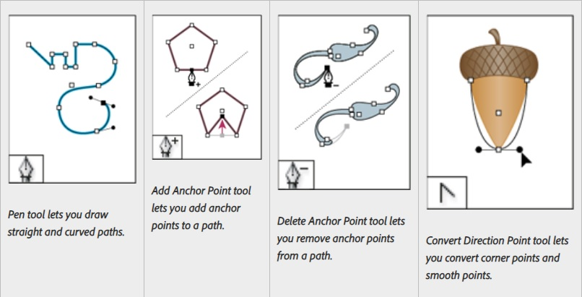

Slide 12
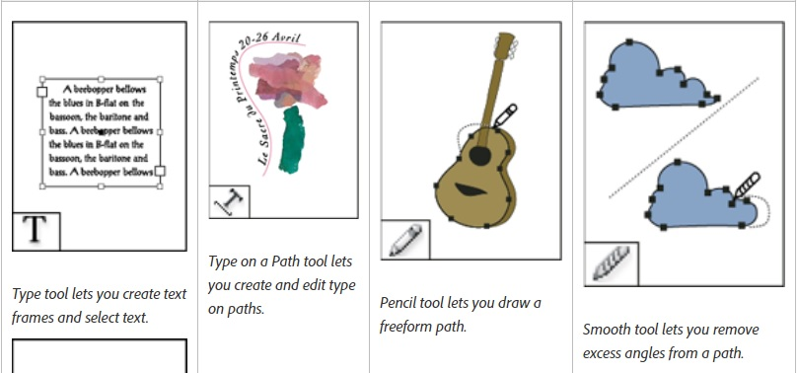

Slide 13
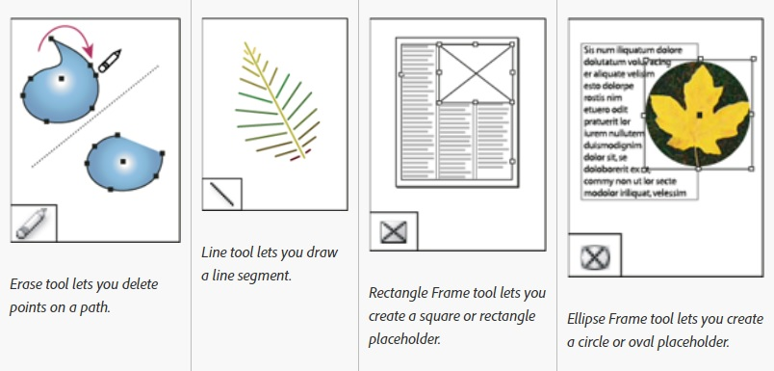

Slide 14
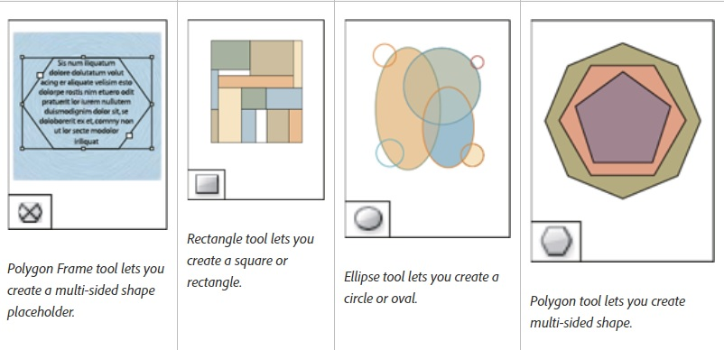

Slide 15
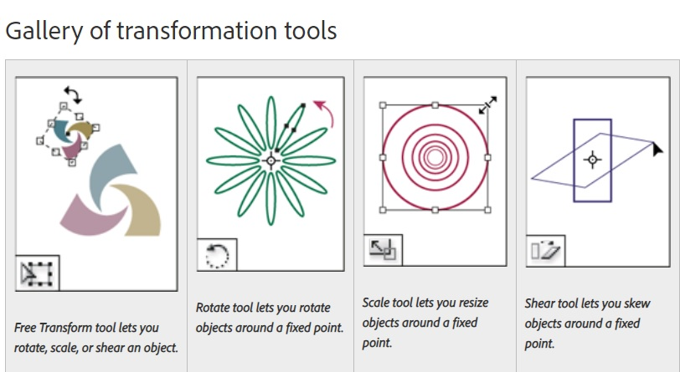

Slide 16
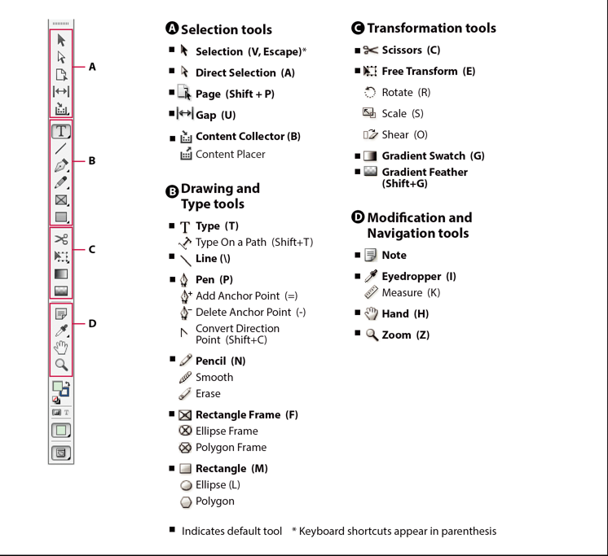
Toolbox overview:
Some tools in the toolbox are for selecting, editing, and creating page elements. Other tools are for choosing type, shapes, lines, and gradients.

Slide 17
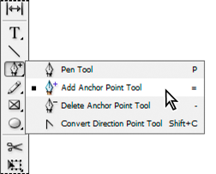
Hidden tools in the toolbox:
The toolbox also contains several hidden tools related to the visible tools. Hidden tools are indicated by arrows to the right of the tool icons. You can select a hidden tool by clicking and holding the current tool in the toolbox and then selecting the tool that you want.

Slide 18
Tools overview:
Type tools
Create and format type in standard or customized blocks or paths. ( create text frames.)
Drawing tools
Draw and style simple and complex objects, including rectangles, ellipses, polygons, freeform shape
Selection tools
Select (activate) objects, points, or lines.
Transform tools
Reshape, reorient, and resize objects.
Navigation tools
Move around in, control the view of, and measure distances in a document.
The Scissors tool
Splits paths and frames.

Slide 19
How to make a Flyer?

Slide 20
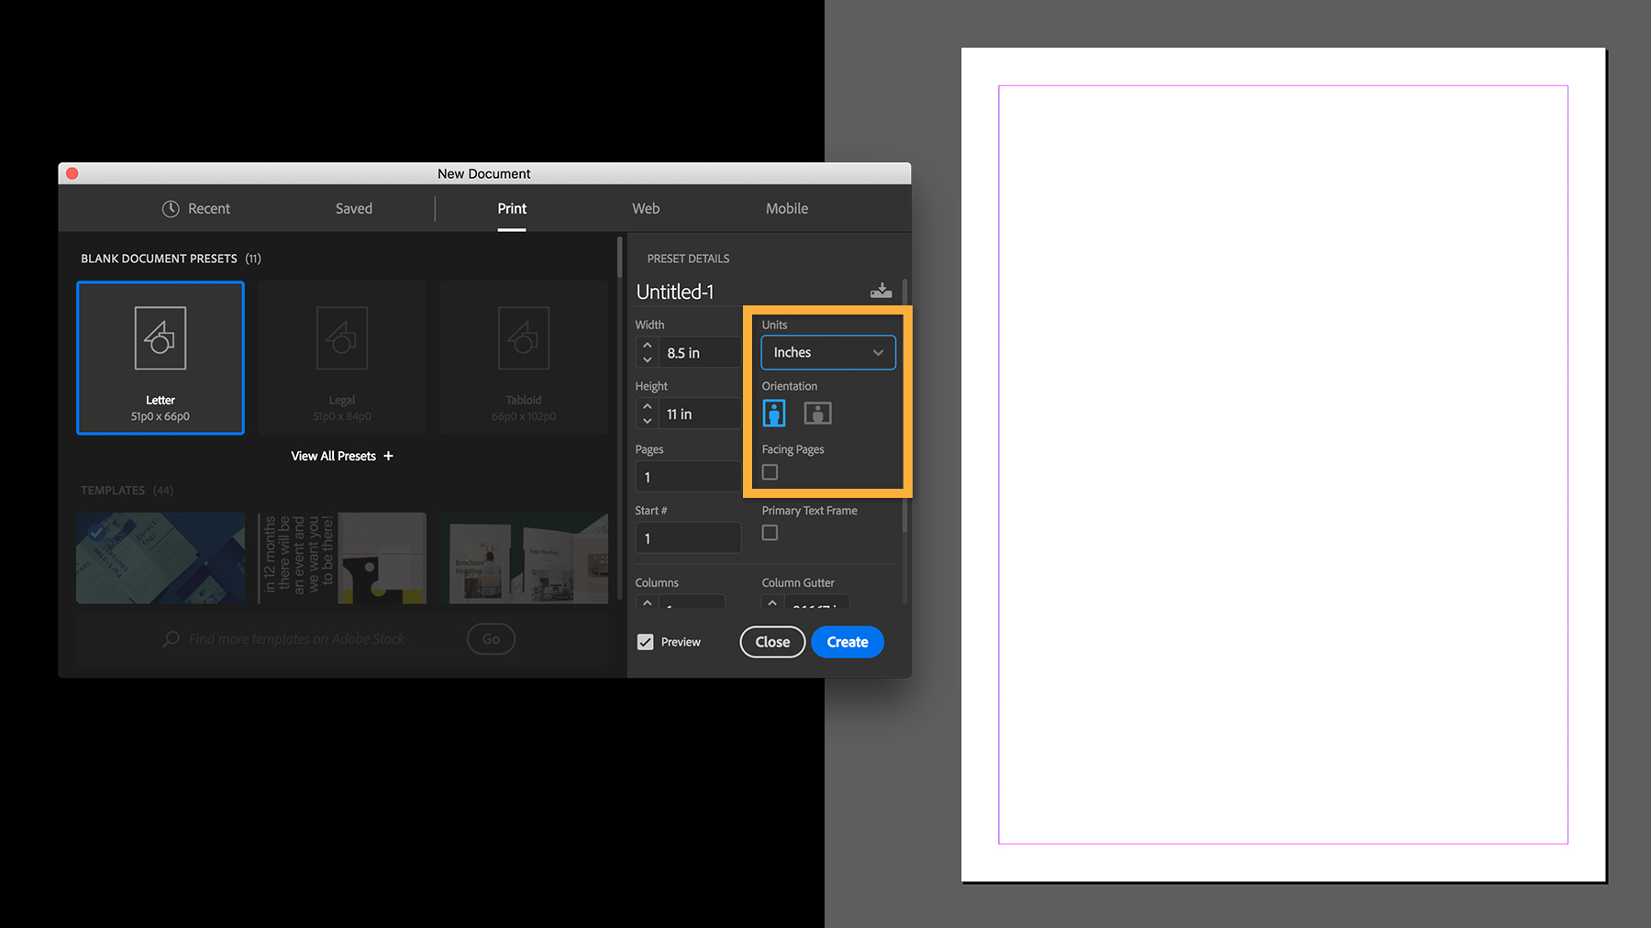
Start with a brand-new document

Slide 21
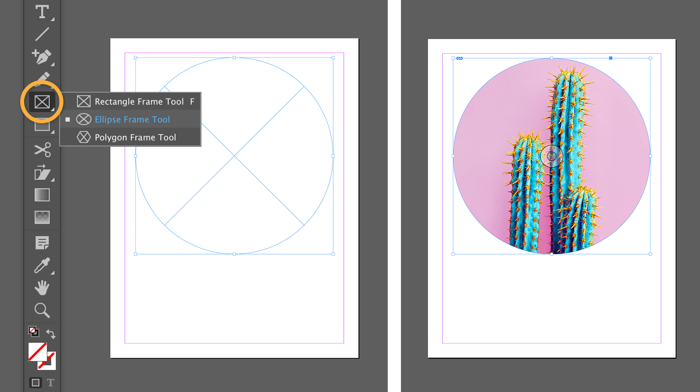
2. Add a strong image

Slide 22
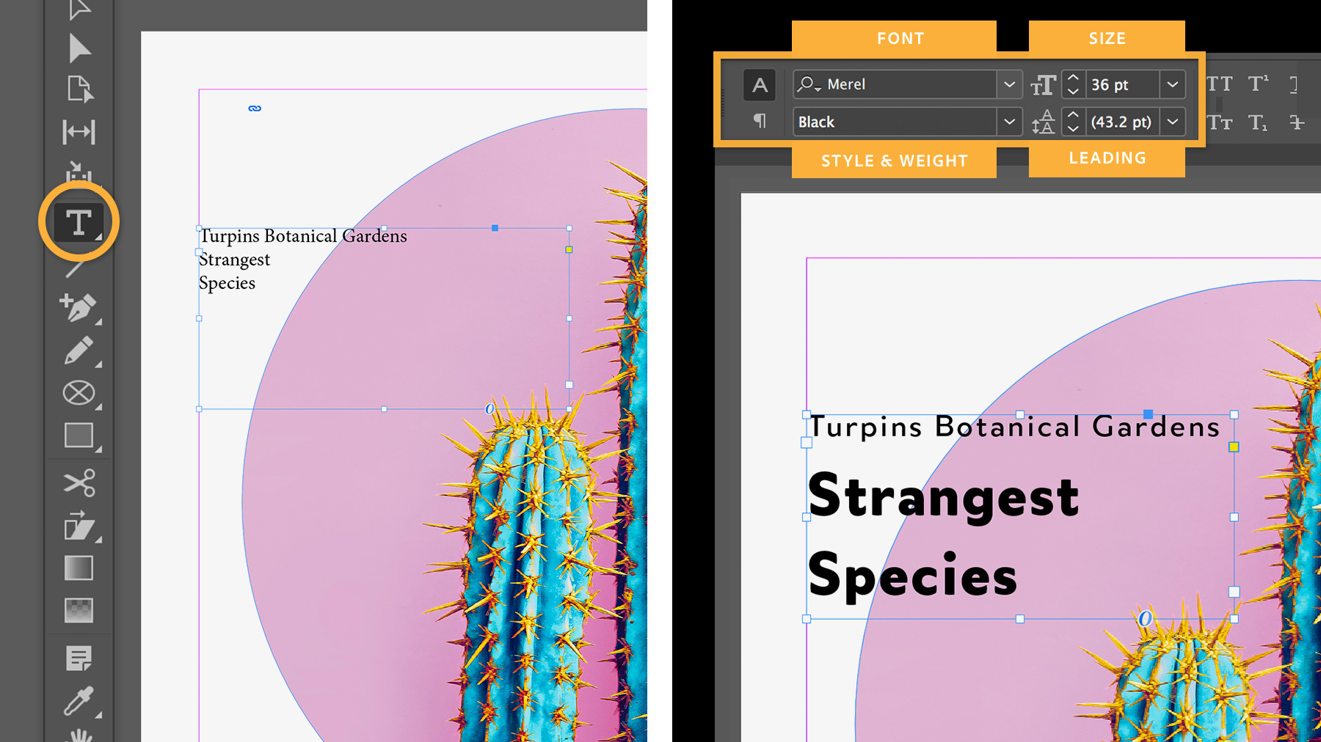
3. Create an impactful heading

Slide 23
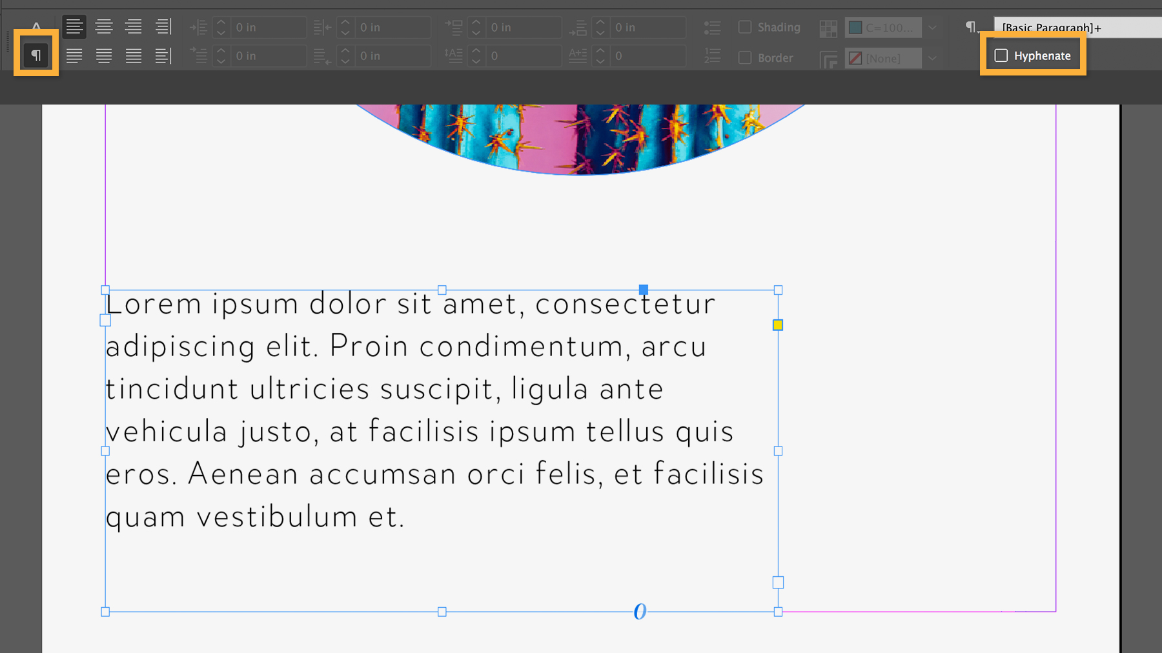
4. Add the remaining text and format it

Slide 24
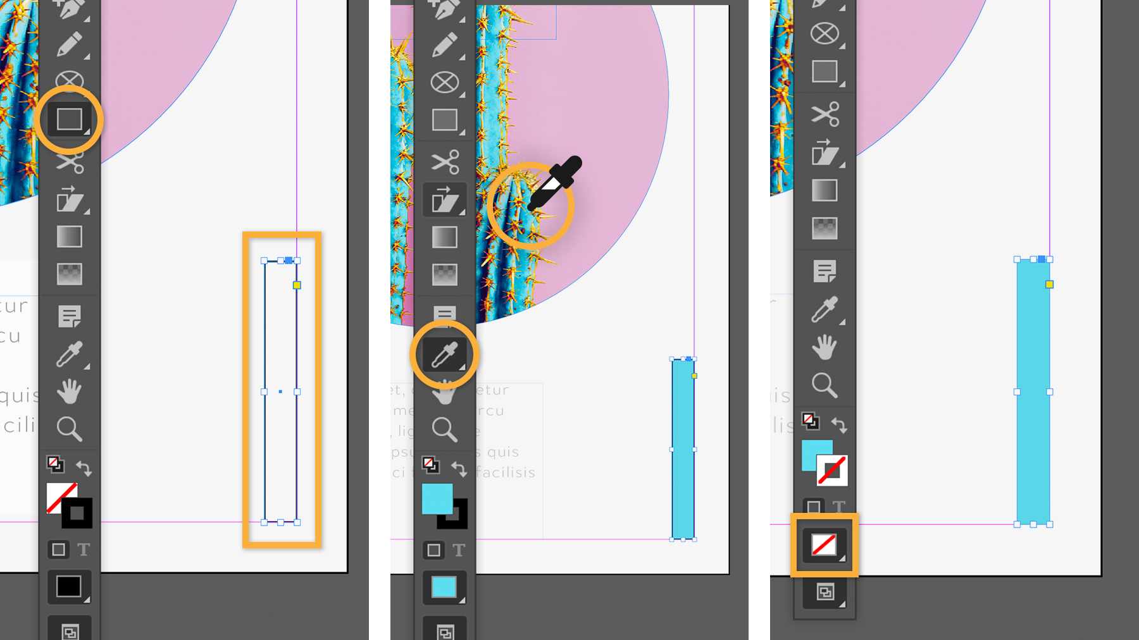
5. Add flair with design elements

Slide 25
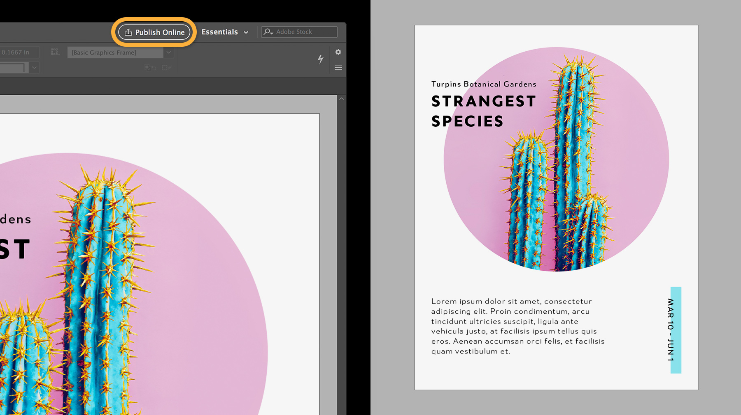
6.Prepare your flyer for printing or sharing

Slide 26
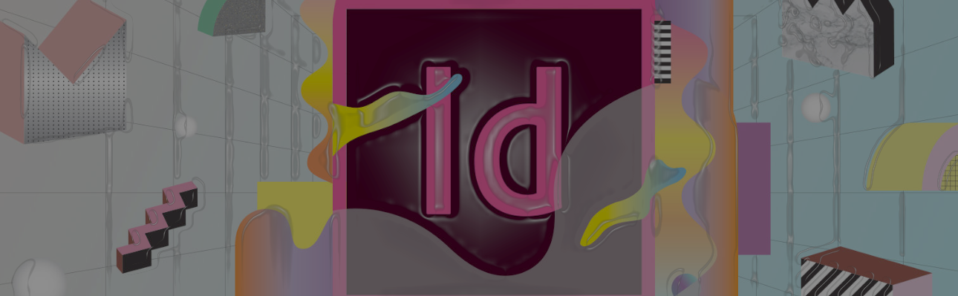
How TO ACCESS free templates?
BEST IN DESIGN TEMPLATES
IN DESIGN SKILLS

Slide 27
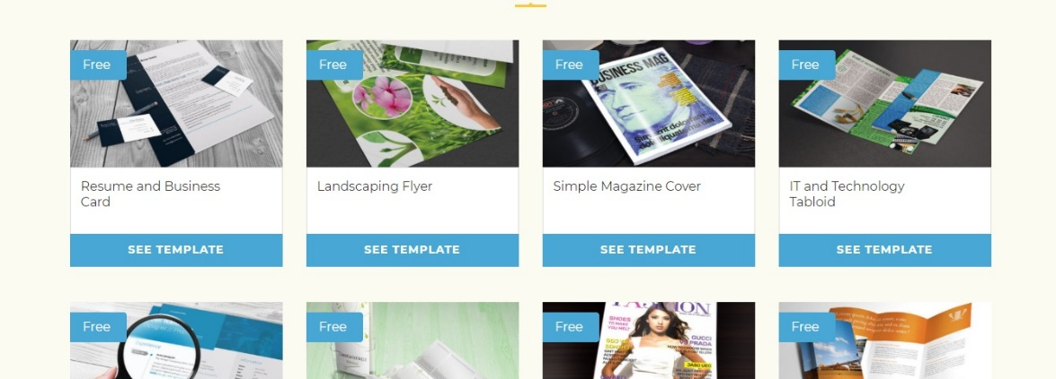

Slide 28
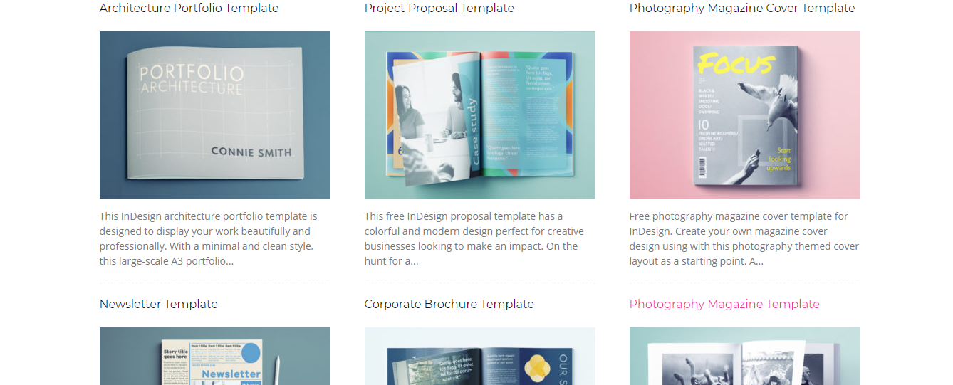

Slide 29
Why iNdesign?
Plenty of fine-tuning options for printing on high-end print and plating systems.
Insert elements from other programs (i.e. Illustrator) without converting those elements into pixels. In other words, files retain their native format.
Designed with multi-page projects specifically in mind
Easily create elements that exist on all pages (page numbers, headers, etc.)
File sizes are smaller than if a similar design were saved in, for example, Photoshop.

Slide 30
ADOBE INDESIGN IS A VERTILE APPLICATION, AND THERE IS ALWAYS SOMETHING NEW TO LEARN. USE AN EXISTING LAYOUT AS A GUIDE, AND TRY TO RECREATE IT FROM SCRATCH. FAMILIARIZE YOURSELF WITH THE TOOLS AND HAVE FUN EXPLORING IT.
THANK YOU!

